Slide 1
Personal Software Process(PSP)

Slide 2
Personal Software Process

Slide 3
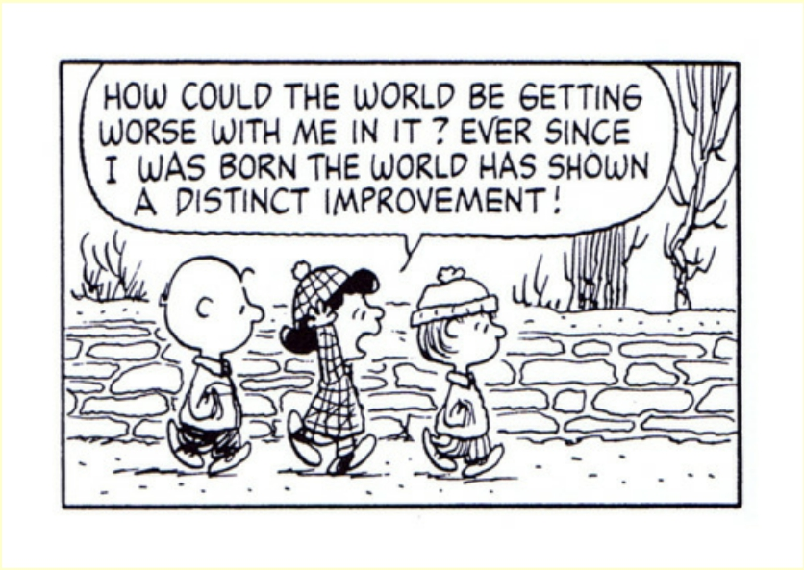
Analogical Reasoning
World = Software Development Project Birth = Me joining the development team

Slide 4
The Personal Software Process (PSP)
The software process is about making software engineering groups/teams work to the best of their abilities.
The personal software process is about making individual engineers work to the best of their abilities.
Through analysis of practical application of the process, the process should be changed for the better.

Slide 5
The Personal Software Process (PSP)
Software engineers should accept responsibility for the quality of their work.
Software engineers can do this only if they have a way of evaluating quality and improving quality (through experience)
The software process improves individual engineers to some extent.

Slide 6
Objective of PSP
Improve their estimating and planning skills.
Make commitments and schedules they can keep and meet.
Manage the quality of their projects.
Reduce the number of defects in their work.

Slide 7
Principles of Personal Software Process
Every engineer is different. For software engineers to become more active, they should plan their work and base these plans on their personal data.
To improve their performance, software engineers should personally use regular and well-defined processes.
For software engineers to produce quality software products, they should feel personally responsible for the quality of the products they are making. Superior software products are never created by mistake but by striving to do quality work.

Slide 8
Principles of Personal Software Process
It’s cheaper to trace and fix defects earlier than later.
It’s easier to prevent errors than finding and fixing them.
The cheapest and fastest way to do any task is doing it in the right direction.

Slide 9
Criticism of the PSP
The PSP is not universally accepted:
some think it is a good idea in theory but not in practice
some think that it is not flexible enough
some think that it is too time consuming
some think it should be up to individuals to find their own way of working
The PSP fails, when it is used by the team to criticize individuals.

Slide 10
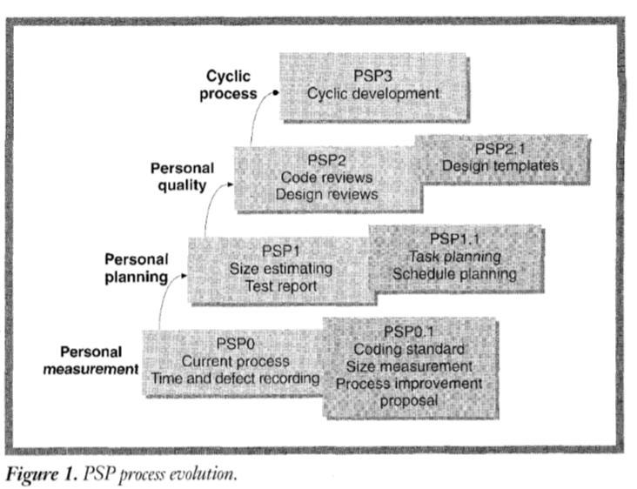
PSP Process Evolution

Slide 11
PSP0: Personal Measurement
Engineers gather data on the time they spend by phase and the defects they find.
Generates real, personal data and provides the base benchmark for measuring progress
PSP0 adds a coding standard, size measurement and a process improvement proposal

Slide 12
PSP Basic Measures
Development Time: measured in minute using a time recording log designed to account for interruptions
Defects: any change to the design or code to get the program to compile or test correctly; recorded in a defect recording log
Size: lines of code, used primarily for estimating development time; new, modified and re-used code is distinguished.

Slide 13
Line of Code (LOC)
Source lines of code (SLOC), also known as lines of code (LOC), is a software metric used to measure the size of a computer program by counting the number of lines in the text of the program's source code.
Declarations, Actual code including logic and computation.
Blank Lines, Comments

Slide 14
Line of Code (LOC) Example
LOC = 4 LOC= 12
Python
#addition of two number
def add(a,b):
return a+b;
4) #Function calling
5)
6) res=add(2,3)
7) print(res)
C Language
1) #include<stdio.h>
2) int add (int,int);
3) void main()
4) {
5) int res;
6) res=add(2,3);
7) printf(res);
8) }
9) \\addition of two number
10) int add (int a,int b)
11) {
12)
13) return a+b;
14) }

Slide 15
PSP1: Personal Planning
This step must introduce some method for estimating sizes and development times for new programs based on personal data
The methods employed are usually (should be) based on linear regression with prediction intervals to indicate size and estimate quality.
PSP1.1 adds schedule and task planning

Slide 16
Size Measurement
The planning process starts with an estimate of the job size.
By estimating the size of the product that you plan to build, you can better judge the amount of work needed to build it.
Before you can estimate the product size, you need to select an appropriate size measure.

Slide 17
Size Measurement Criteria
The criteria for a size measure are that it must be
useful for planning
directly countable/measurable

Slide 18
Useful for Planning
A primary goal in planning is to estimate the effort for a job.
For a size measure to be useful during planning, it must help you to estimate the effort for the job.
To help you estimate the effort for the job, there must be a relationship between the size measure and the effort for the job.
If a relationship exists between a size measure and effort, then the size measure can be used for planning.
The next slide illustrates such a relationship for writing pages of text for a book.

Slide 19
Directly Countable
The size measure must be directly countable or measurable in the product.
Examples of directly countable measures are
pages
paragraphs
diagrams
graphs
Examples of something that is not directly countable in a document are themes or topics.

Slide 20
Effort Measure
While the size measure depends on the job, the effort measure is always time.
The concerns with measuring time are these.
What is included in the time measure?
What precision is used to measure time?

Slide 21
What is Included in the Time Measure?
Since you are looking for a relationship between size and effort, only the time spent actually working on a task (“time on task”) should be included.
Interruptions such as phone calls, rest breaks, and office conversations
are highly variable
are not related to the job
must be excluded from task time in order to determine the size versus time relationship
Most engineers find that they spend less than 50% of their time on task.

Slide 22
Time Measurement Precision
Effort on projects is often measured in person months.
While this is useful for financial accounting systems, it is not useful for tracking, analyzing, or improving personal processes.
People rarely work on one thing for more than an hour or two.
In PSP, effort is measured in minutes.
This measure is precise enough.
Once you decide to precisely measure time, the units do not make much difference.

Slide 23
Selecting a Size Measure -1
Start with some historical data from past projects.
development effort
product characteristics (candidate size measures)
Rank the products by development effort.
See what characteristics distinguish those products that took the greatest effort from those that took the least.

Slide 24
Selecting a Size Measure -2
Determine if the candidate size measure is related to effort.
Create a graph with the candidate size measure on the horizontal axis and effort on the vertical axis.
Plot each pair of historical data (candidate size measure, effort) as a point on the graph.
If the points define a line, then the candidate size measure is related to effort and can be used for planning.
There may be no single best size measure. A combination of size measures could be needed.

Slide 25
Ex: Text Pages versus Writing Time
No. of Text Pages | Writing Time (min)
5 | 15
10 | 30
15 | 45
20 | 60
25 | 75
30 | 90
35 | 105

Slide 26
Ex: Text Pages versus Writing Time

Slide 27
Ex: LOC versus Development Time
LOC | Development Time (min)
5 | 4
10 | 6
15 | 8
20 | 10
25 | 12
30 | 14
35 | 16

Slide 28
Ex: LOC versus Development Time

Slide 29
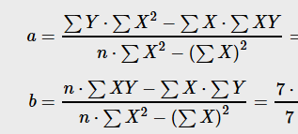
Estimation of development time using regression model.
y = a + b⋅x
a= 2
b= 0.4
y= 2+0.4x

Slide 30
Ex: LOC versus Development Time

Slide 31
Estimating Effort Directly
If you cannot find a good size measure, you may have to estimate development time directly.
Collect a lot of historical data.
Compare the new work with past work.
Judge the likely development time.

Slide 32
PSP2: Personal Quality
This step introduces defect management
Using data from PSP exercises, engineers construct and use checklists for design and code review
From their own data, they see how checklists help personal reviews
PSP2.1 adds design specification and analysis techniques along with defect prevention, process analyses and process benchmarks

Slide 33
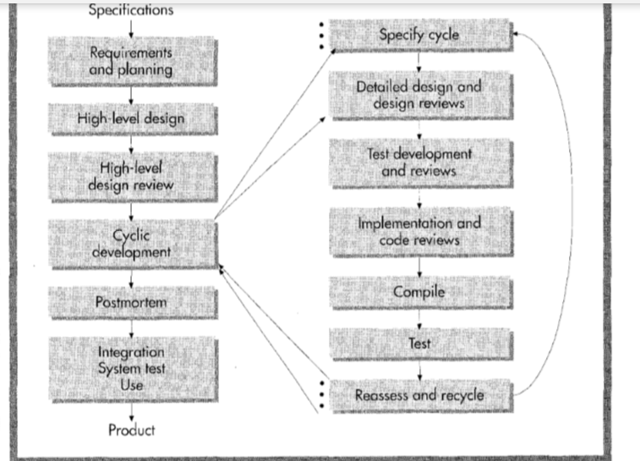
PSP 3: Cyclic Process

Slide 34
PSP Quality Strategy
Defects are basic quality measure
Engineers should:
•remove them
•determine their cause (type)
•learn to prevent them
PSP uses private review with the goal of finding all defects before 1st compile and test

